Slide 1

ESCAP/WMO Typhoon Committee 18th IWS/ 4th TRCG Bangkok, Thailand
Forecasting of Tropical cyclone Ex-tropical Transition in the Northwestern Pacific
Xiang Chunyi*, Wang Qian
National Meteorological Center,
China Meteorological Administration
2023-11-30

Slide 2
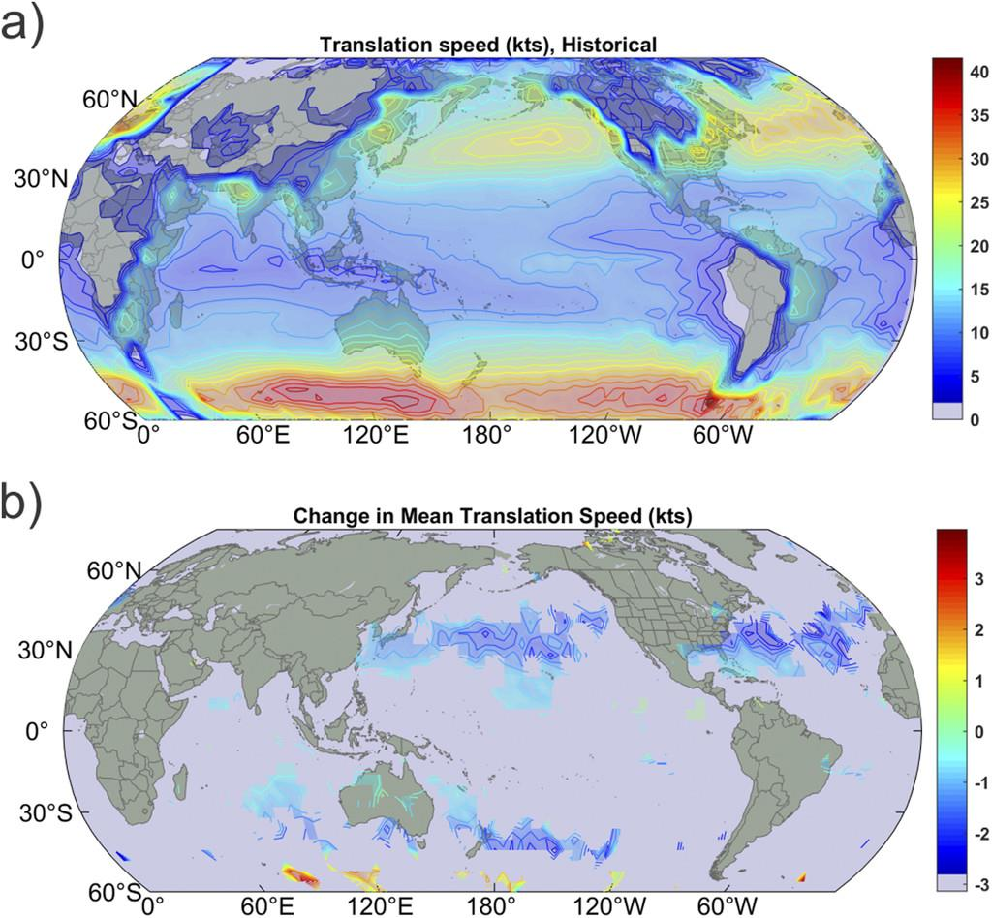
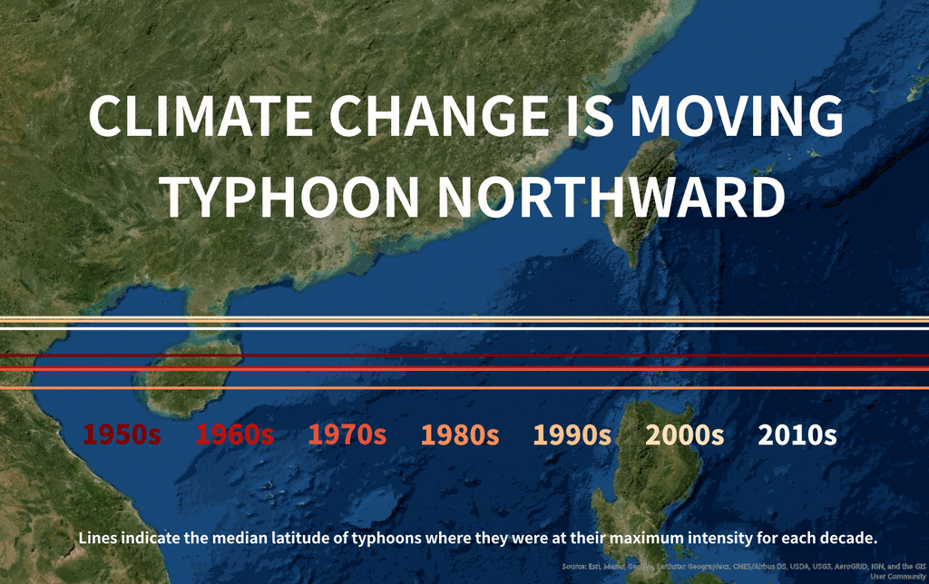
Motivation
The lastest International Panel on Climate Change (IPCC) report highligt that :
“The rate of intensification and number of strong tropical cyclones have increased, and tropical cyclone tracks likely migrated poleward.”
  Number of strong tropical cyclones has increased
  Tropical cyclone tracks likely migrated northward
(Emanuel JC 2021)

Slide 3
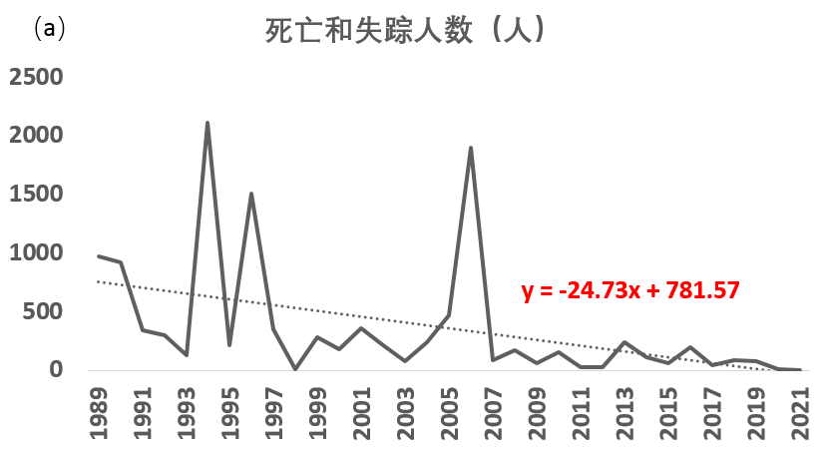
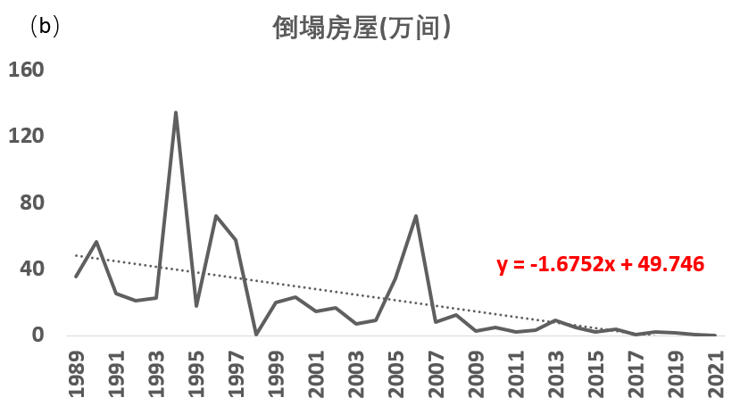
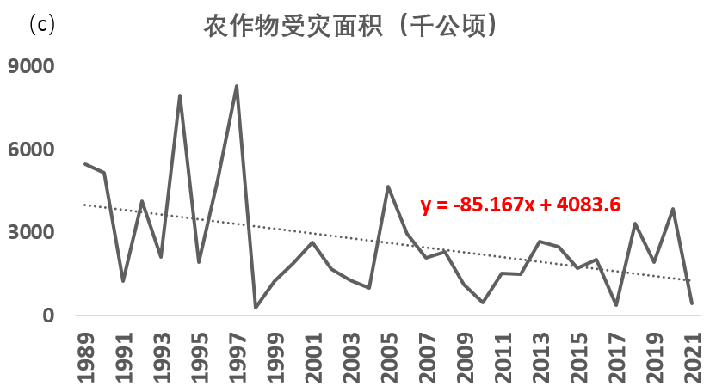
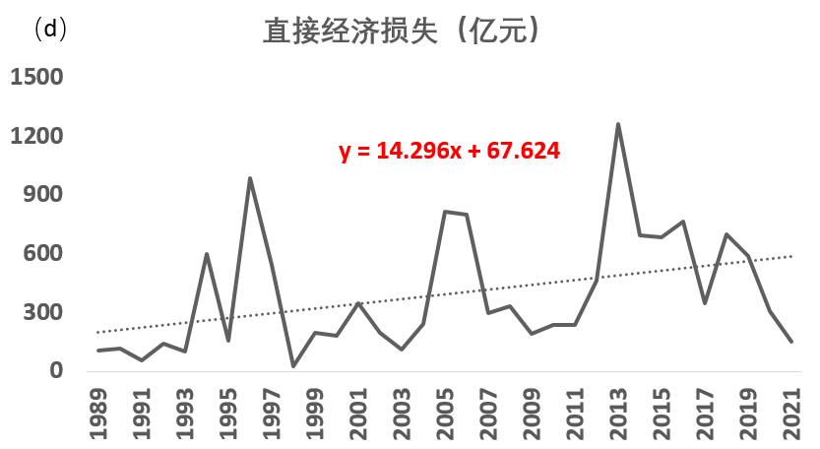
Motivation
Typhoon disasters account for a high proportion of meteorological disasters
Over the past 33 years, although the number of tropical cyclones that have landed in China has not shown a significant linear trend, the number of tropical cyclones that have caused disasters has increased.
Changes in spatial distribution of typhoon
Increasing in TC disasters losses in Southwest and North China in the past decade
Courtesy from STI/CMA

Slide 4
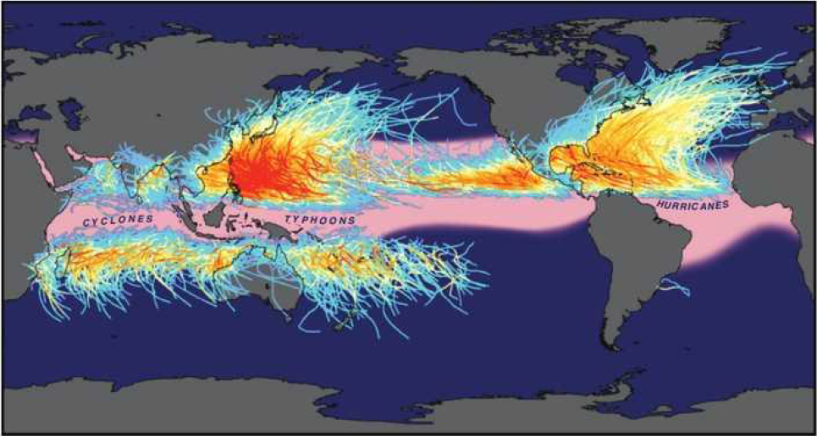
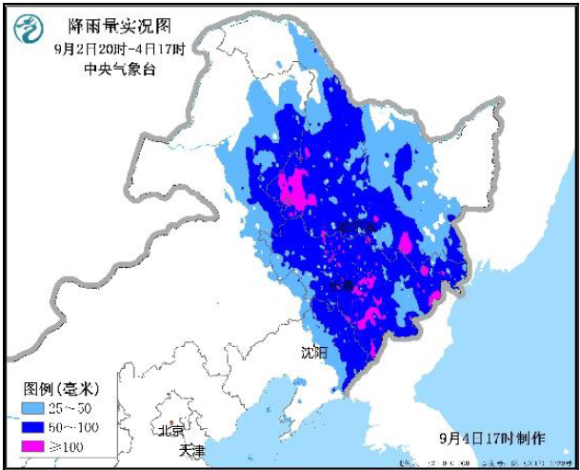
Background
About 35% of tropical cyclones (TCs) undergo ET over the western North Pacific
During ET, the cyclone structure changes and develops rapidly. The expansion of the gale area and the enhancement of TC asymmetry bring significant challenge to the TC forecast.
35%
29%
Global Tropical Cyclone Tracks
Precipitation
About 7 to 10 TCs make landfall along the western North Pacific coast each year are contributed by cyclones that are undergoing or have completed ET. The gale and heavy rainfall associated with ET brought huge economic damage to related contries.
TC
ET
EC
ET TC tracks
MAYSAK(2020)
Notes:
研究价值

Slide 5
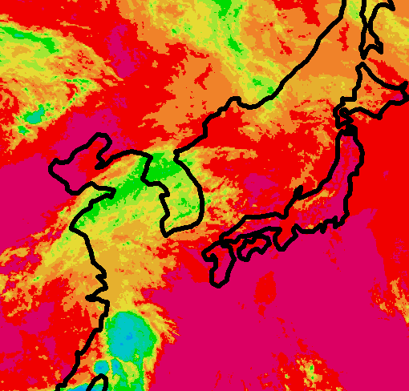
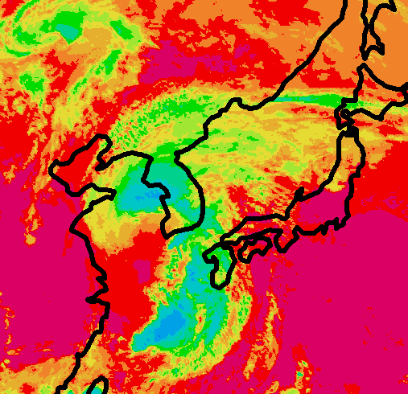
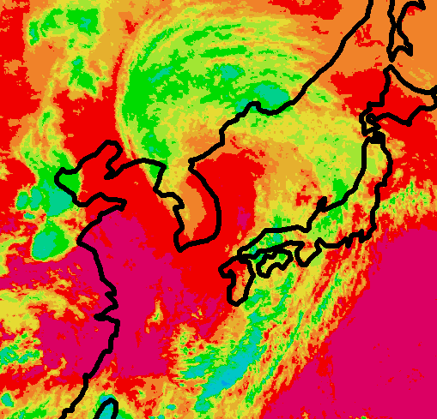
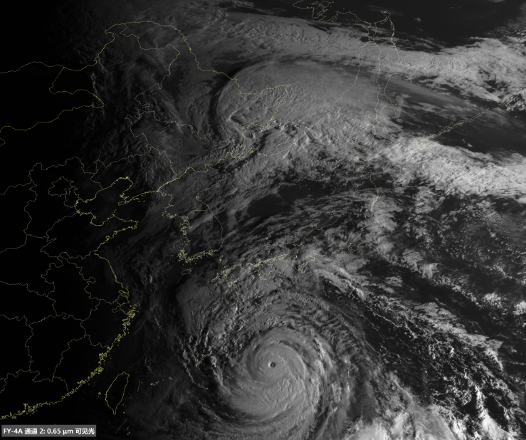
Background
Tropical Cyclones undergoing Extratropical Transition (ET) while moving polarward and interacting with mid-latitude weather systems, gradually turned to an Extratropical Cyclone.
MUIFA after ET
TC NANMADOL
Extratropical Transition (ET)
Tropical Cyclone (TC)
Extratropical Cyclone (EC)
Hybrid
ET process of TC is often accompanied by high-impact weather and severe sea conditions, resulting in serious economic losses and casualties
Notes:
变性的概念

Slide 6
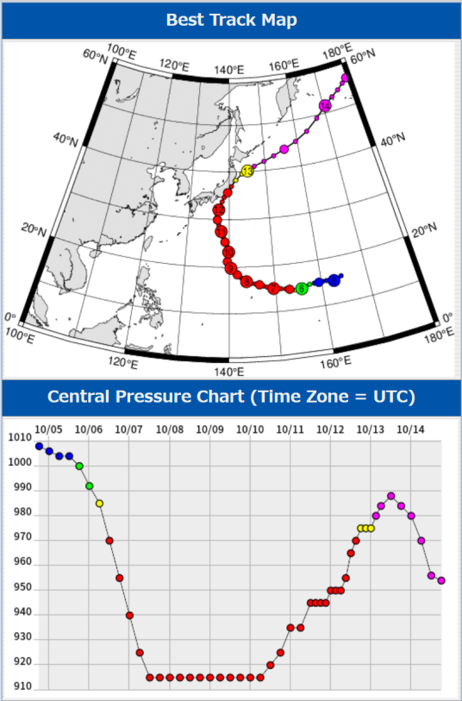
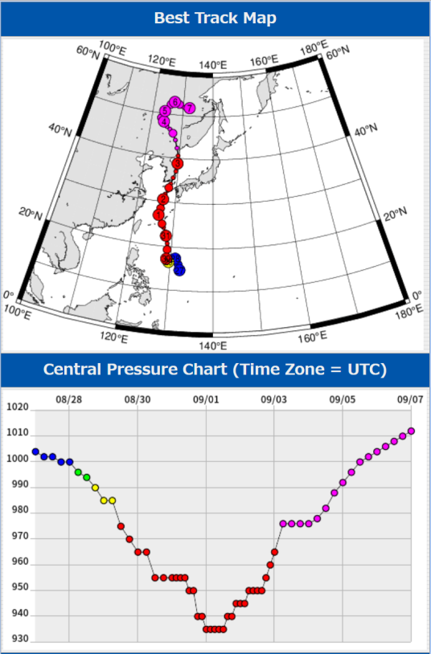
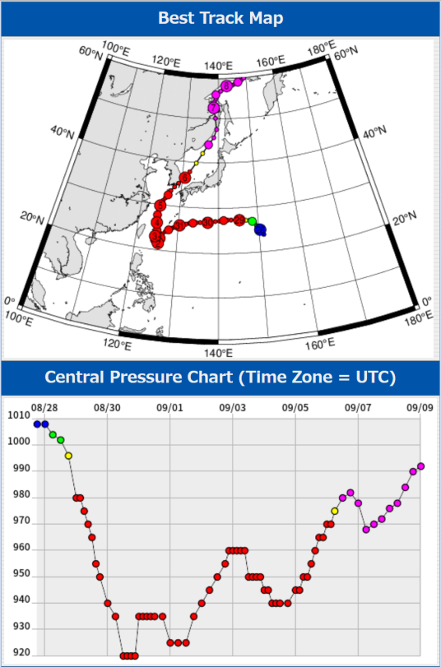
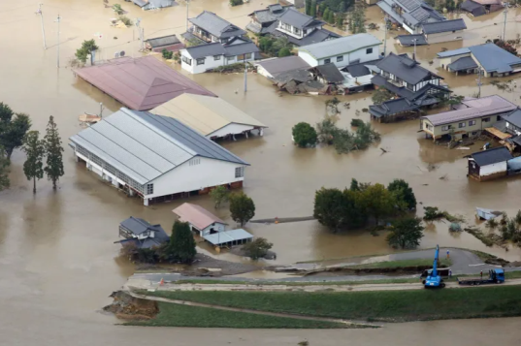
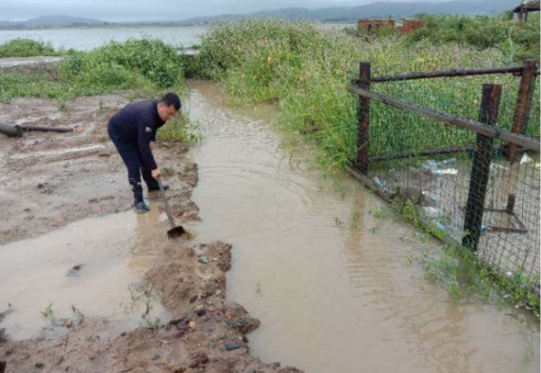
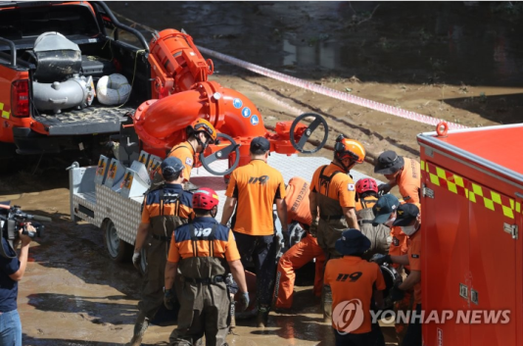
Background
The ET process involves complex interactions between TCs and mid-latitude systems. For the same typhoon, the ET time determined by the CMA, JMA and KMA is often different.
The establishment of a unified criteria in Northwestern Pacific Ocean will provide a reference for the scientific research of ET process, with a unified standard and product interpretation for meteorological disaster early warning in this region.
HAGIBIS
(Oct. 2019)
MAYSAK
(Sept. 2020)
HINNAMNOR
(Sept. 2022)
(Source: Digital Typhoon)
台风变性致灾个例 High-impact ETCs cause severe disaster
Notes:
据日媒报道，日本农林水产省透露，截至当地时间25日上午7时，台风“海贝思”对该国农业、林业、渔业等相关领域造成的损失额已达1027.3亿日元 (约合人民币67亿元)。
台风“海贝思”重创日本农林渔业 损失逾千亿日元-中新网
统计2001-2020年JMA和CMA关于变性TC的判定的结果可见，两家机构关于变性TC的认定有很大差异，占CMA总变性TC数量的45%，占TC总数的19.8%。

Slide 7
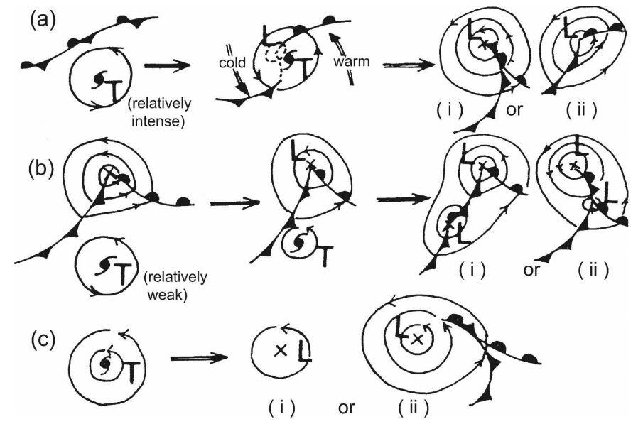
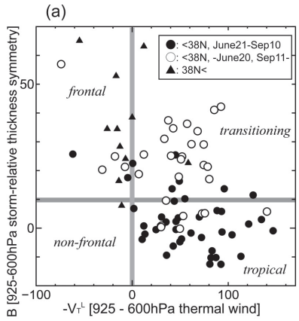
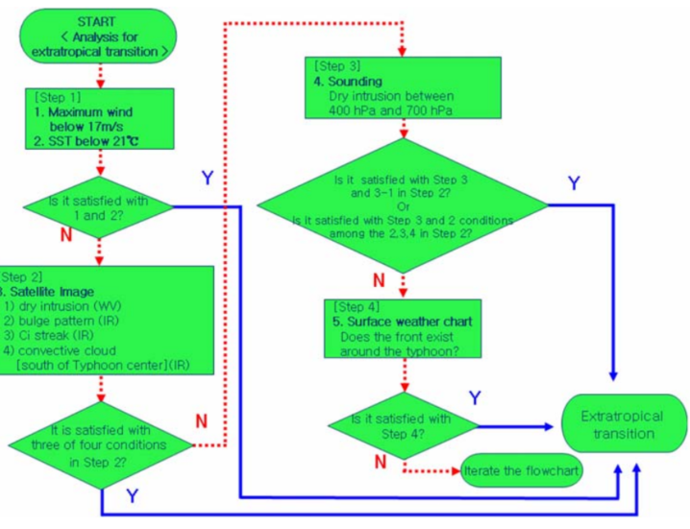
Previous research
Japan Meteorological Agency, 1990: Manual of the operational forecasting of tropical cyclones. 150pp
Naoko KITABATAKE ，2011，Climatology of Extratropical Transition of Tropical Cyclones in the Western North Pacific，Defined by Using Cyclone Phase Space，JMSJ, Vol. 89, No. 4, pp. 309–325, 2011
Eun-Jeong Cha, Jae-Kwan Shim and H. Joe Kwon, 2008, A Review on the Decision-making Process for Extratropical Transition of Typhoon from an Operational Forecast Point of View,JKESS, v. 29, no. 7, p. 567−578
(JMA, 1990)
(Kitabatake, 2011)
(Cha et.al. 2008)

Slide 8
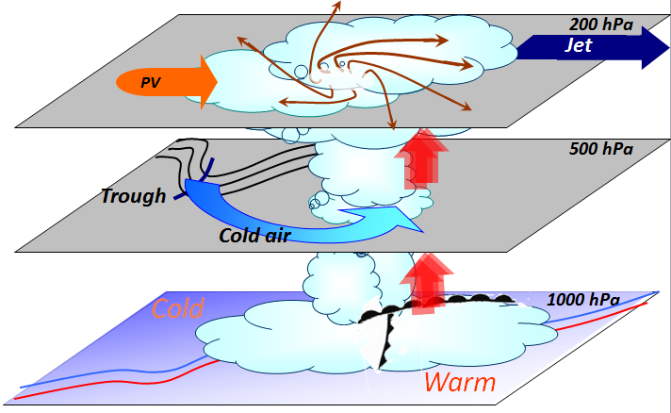
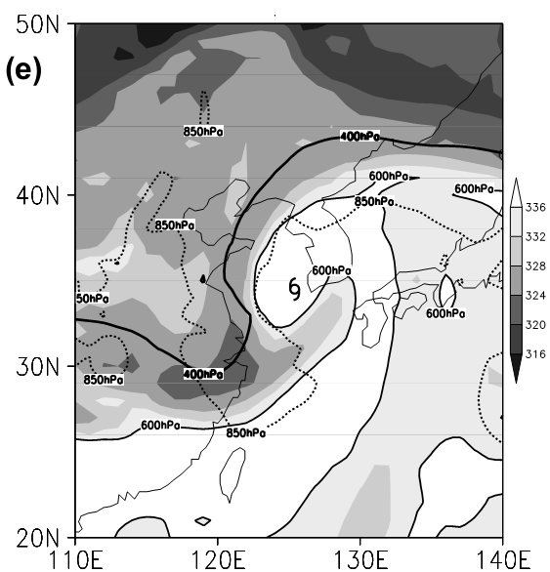
Previous research
Song, J., J. Han, and Y. Wang, 2010: Cyclone phase space characteristics of the extratropical transitioning tropical cyclones over the western North Pacific, Acta Meteor. Sinica, 25, 78–90
Qian Wang, Qingqing Li, and Gang Fu, 2012: Determining the Extratropical Transition Onset and Completion Times of Typhoons Mindulle (2004) and Yagi (2006) Using Four Methods. Wea. Forecasting, 27, 1394–1412.
LI Qingqing and WANG Qian, 2013: Re-examination of the potential vorticity metrics for determining extratropical transition onset and completion times using high-resolution data, Acta Meteorologica Sinica, 27(4), pp 502-508.
(Wang, 2012)
(Li and Wang,2013)
(Yang et al., 2015)

Slide 9
Data
Statistic study:
Period: 6 years from 2016 to 2021
  Number of ET TCs: 57 (41.4% over total TCs)
  Used the CMA-best tracks issued every 12 hours.
  ERA-5 reanalysis data UV winds, geopotential height
Cases:
Time: Lekima(2019); Infa(2021); Muifa (2022)
  Used the ECMWF ensemble forecasting.
  Each memeber to caculate individually within 500km from the TC centers

Slide 10
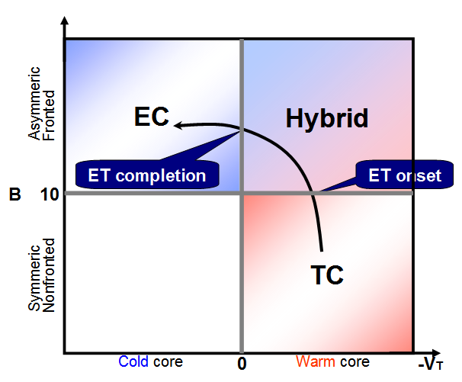

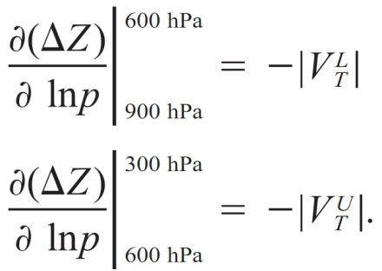
Method
Cyclone Phase Space ( CPS) (Hart, 2003; Evans and Hart, 2003; Hart et al., 2006)
Two parameter：B (Thermal symmetricity- Asymmetric/symmetric)
-V_{T}^{U} , -V_{T}^{L} (Up/low level thermal winds – cold/ warm core).
where
Asymmetric
Cold
Symmetrc
Warm
Onset of ET: B > 10
Completion of ET: B > 10 ，-V_{T} ^{U} < 0 ，-V_{T}^{L} < 0

Slide 11
Statistical analysis of ET

Slide 12
Statistical analysis of ET

Slide 13
Statistical analysis of ET
1
1
1
1
2
1.5
5
2
1.5
1
3
6.5
6
1
4
4
2
1
1.5
3.5
1
1
1

Slide 14
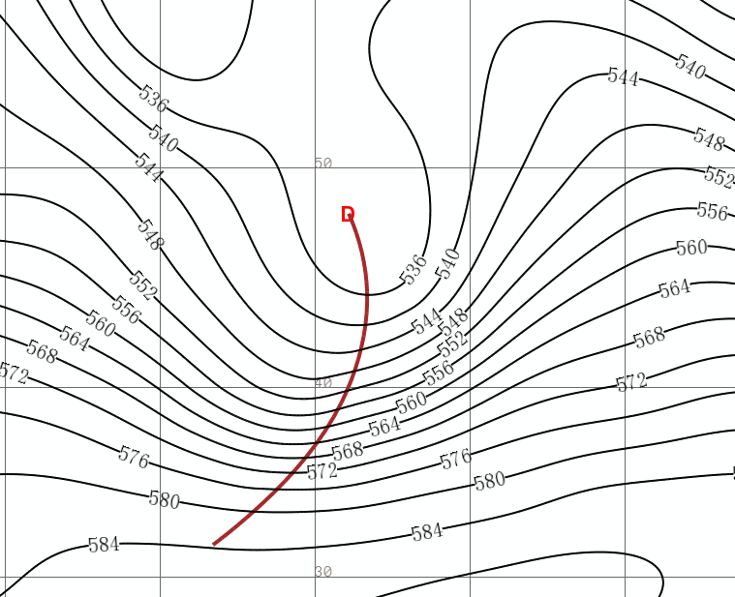
Statistical analysis of ET
West Pattern
(10.5%)
East Pattern
(72%)
South Pattern
(17.5%)
Spring(MAM)
Summer(JJA)
Autumn(SON)

Slide 15
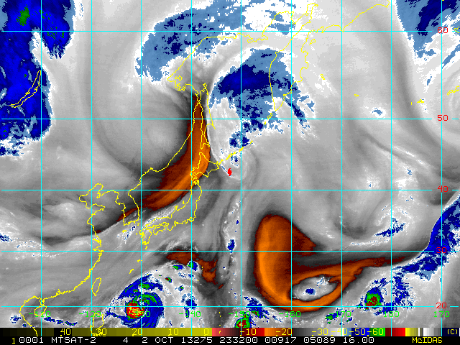
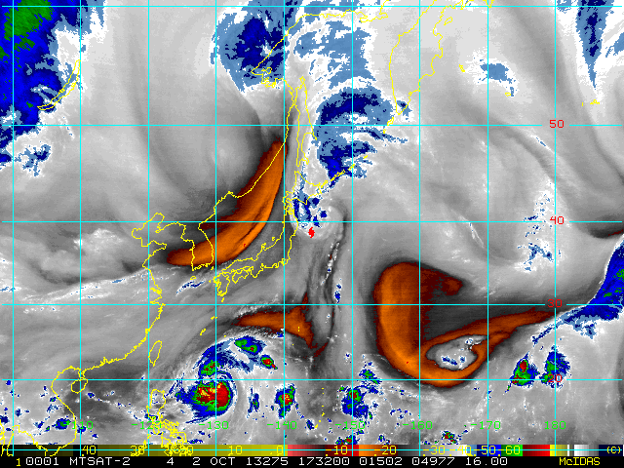
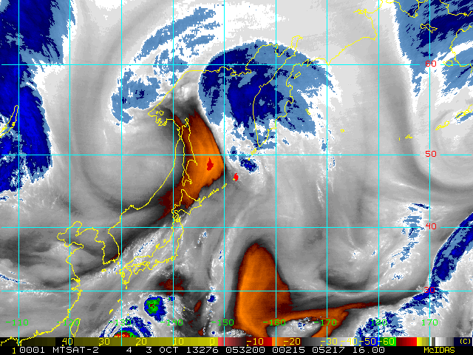
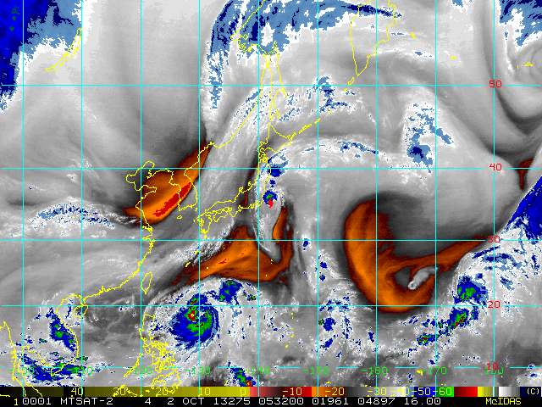
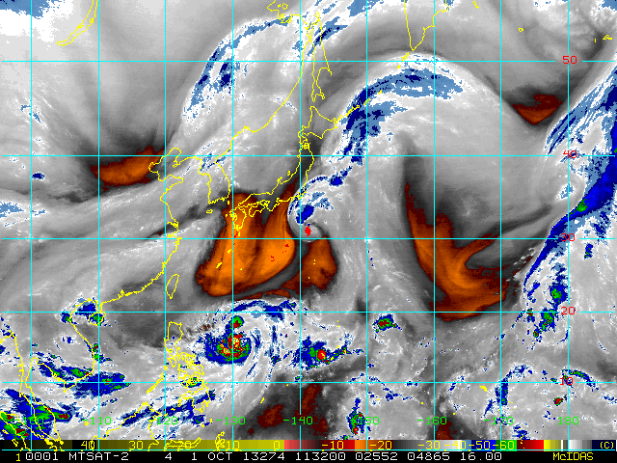
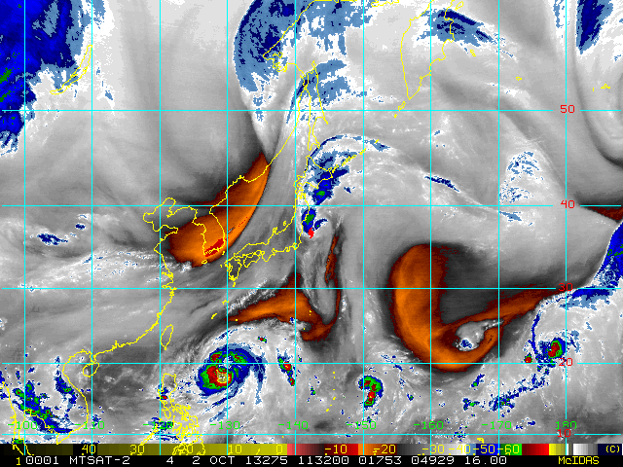
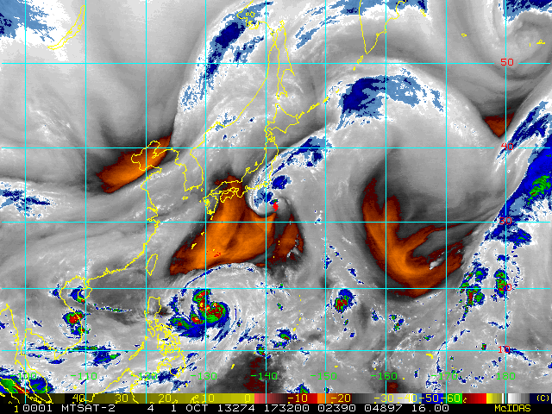
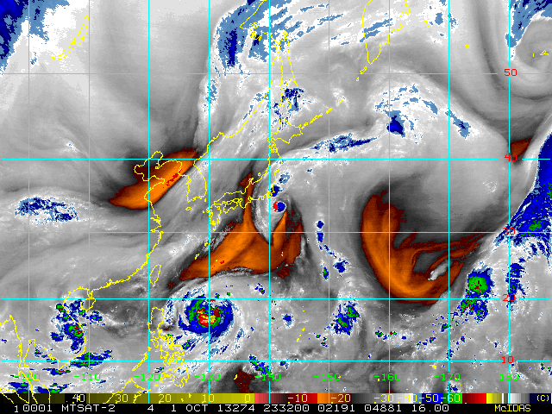
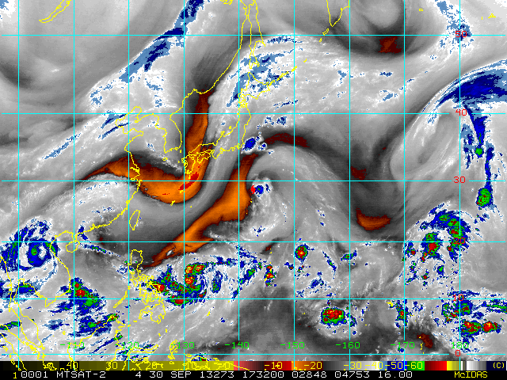
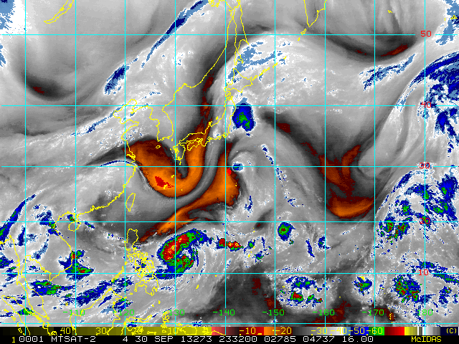
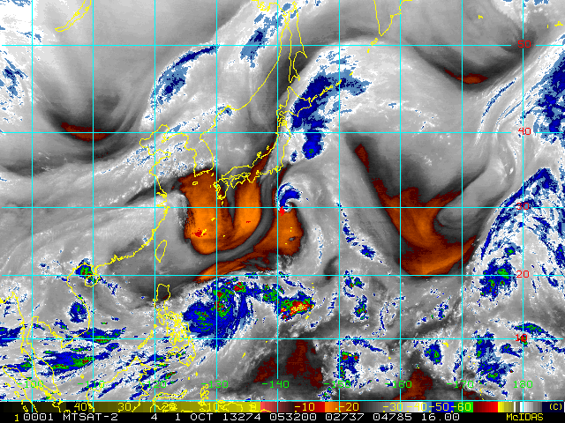
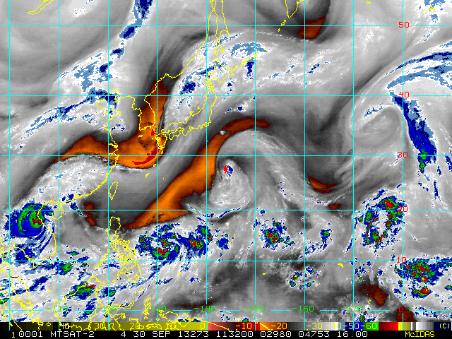
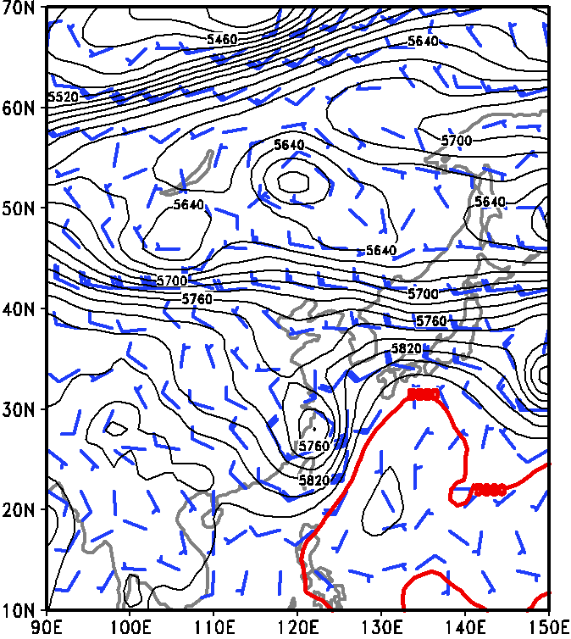
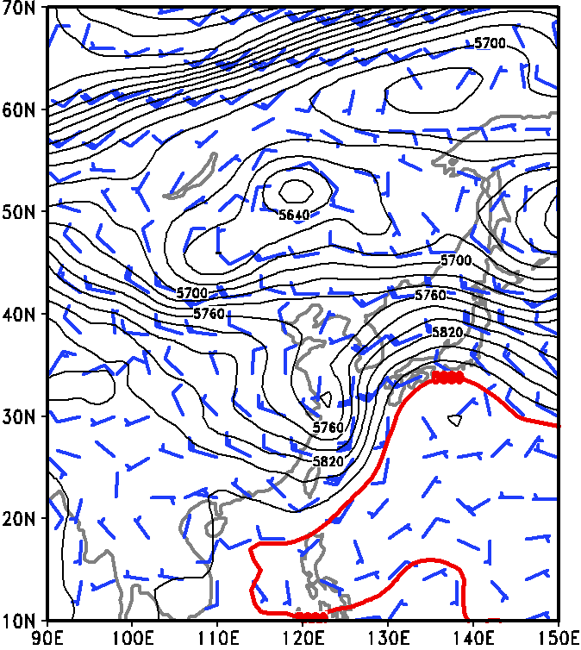
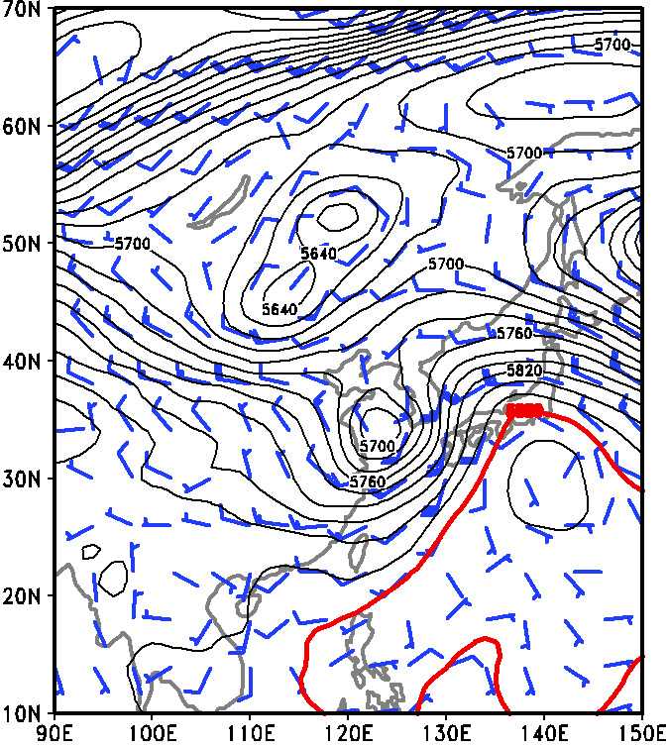
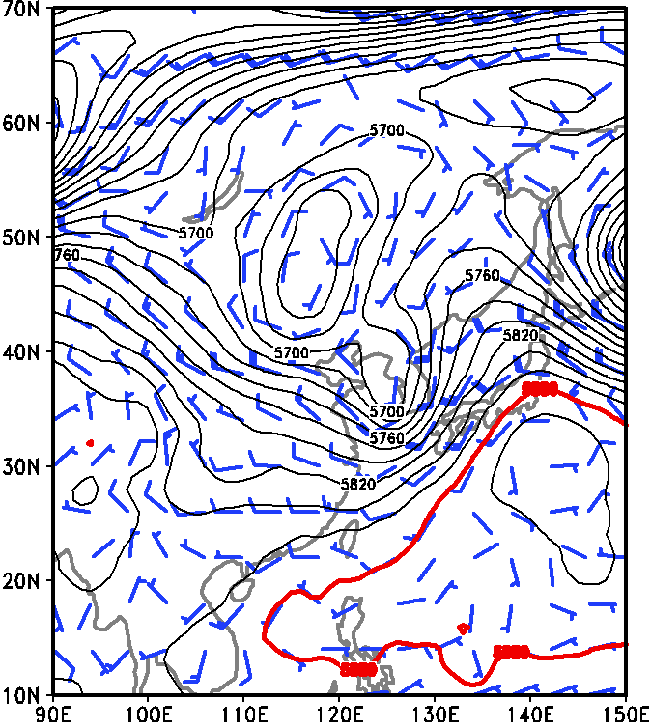
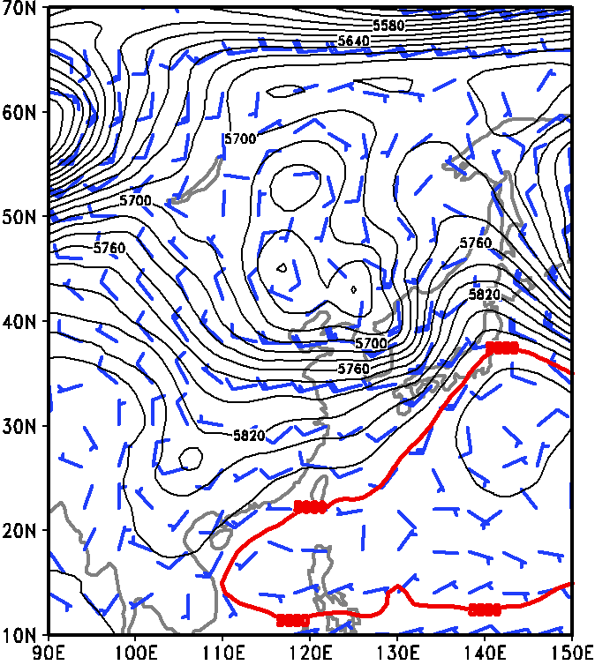
Statistical analysis of ET
East Pattern (41 ET TCs)
Interaction with westerly through (dry air)
Day - 1
Day - 2
Day -3
Day - 4
Day - 5

Slide 16
Objective forecast of ET
Objective Forecast of ET every 12hr based on CMA subjective forecast tracks
Two times(00/12 UTC) from 0 to 120hr every 12hr
Initial Time
BABJ
EC Fcst
ETOC
96
00 +12 +24 +36 +48 +60 +72
24
72
48
72
00
00
12 00 12 00 12 00 12 00 Time
2 Oct. 3 Oct. 4 Oct. 5 Oct.
24
48
00 +12 +24 +36 +48 +60 +72
ETOC
EC Fcst
BABJ
Initial Time

Slide 17
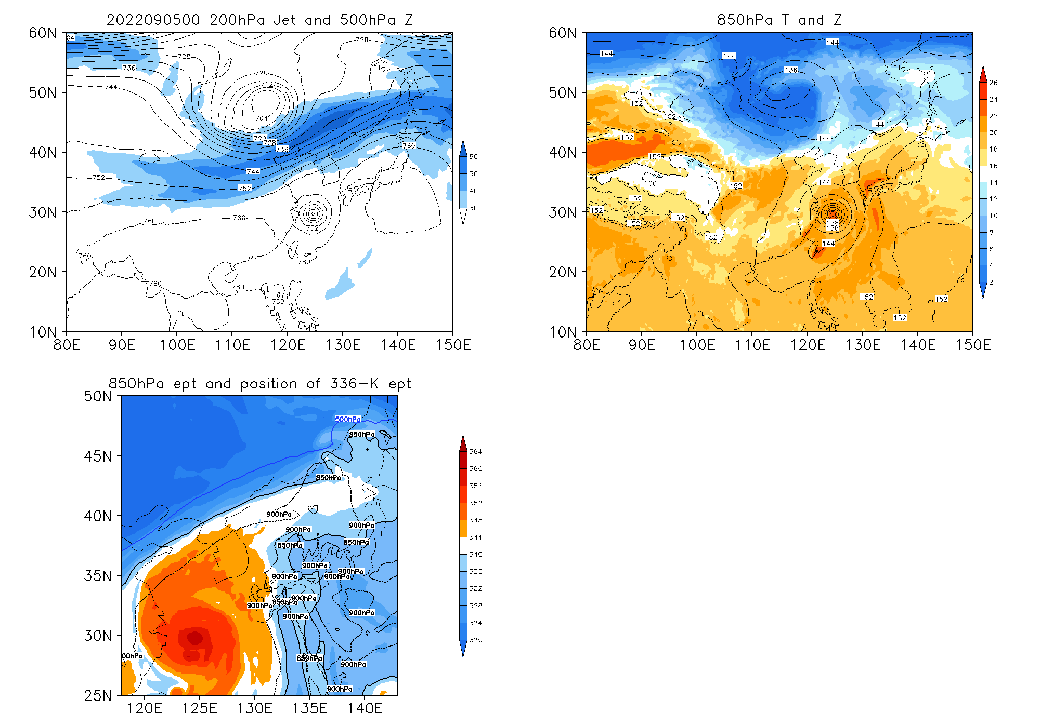
ET forecast of Hinnamnor (2022)
ET will begin in the evening of 5th Sept. and quickly (~20 hours) complete in the evening of 6th Sept.
Notes:
动图

Slide 18
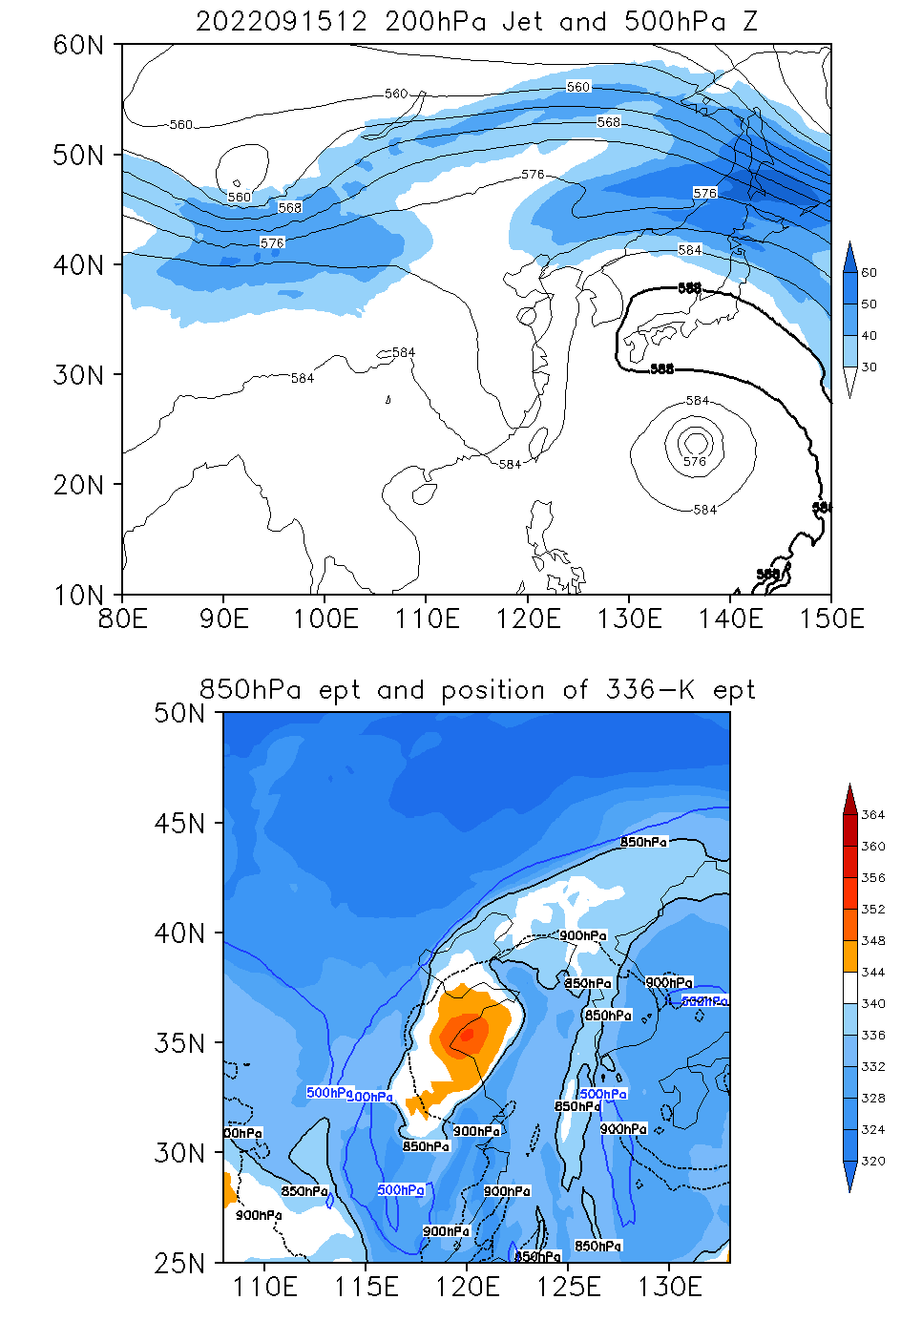
ET forecast of Muifa (2023)
Mufia is under the ET process (14th Spet.)
will complet in the evening 16th to the morning to 17th
冷空气由低层侵入台风核心
Notes:
动图

Slide 19
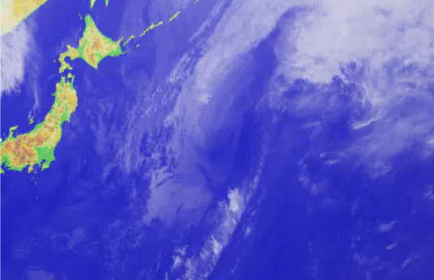
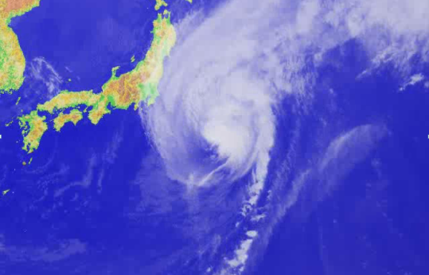
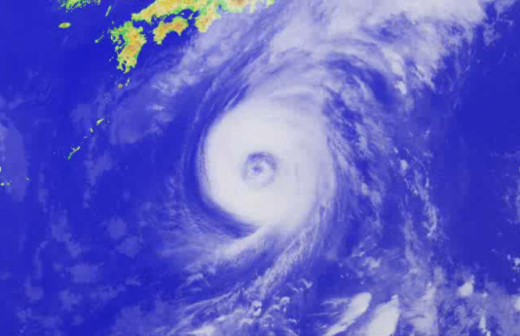
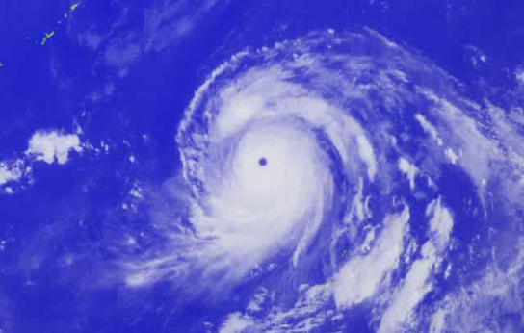
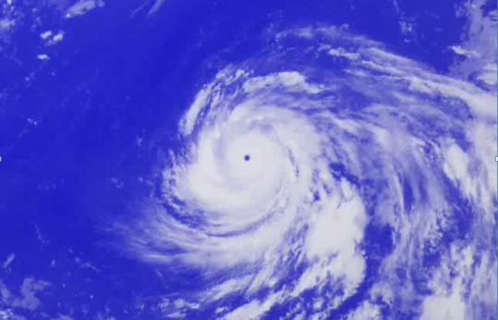


ET Process is an importance stage during the entire lifespane of TC !
Thanks for attentions!

